Slide 1


Billing system proposal Toptel solutions 04 October 2018
Notes:
pe

Slide 2
Group members
Simamkele
Zikhona Nqula

Slide 3

Content
Background
Problem statement
Business Requirements
Functional requirements
System design
-Use cases
- User Interface
Project Plan
Testing
Key take aways
Q&A
Project

Slide 4
Background
Toptel is a Telecomm service provider based Harmunus, a small town just outside of Cape Town. It was established in 2013 by Babalwa Mvula and her Husband Peter van Niekerk and operates mainly in Harmunus and other surrounding small towns where everyone knows everyone,

Slide 5
Background Cont
Recently Toptel has witnessed growth in sales due to their reasonable pricing structure on their data services, seeing that data is expensive in South Africa, and word of mouth has spread all over to reach Cape Town and all other major cities in South Africa. This company has 5 sales consultants who also do the billing process manually on excel.

Slide 6
Basic service offering
Voice Call
SMS & MMS
Internet Connection and Data services
IP based services, i.e., voice over IP or VPN

Slide 7
Current Billing system
Rental Charges
Usage Charges −
− These are the charges taken from the customers on monthly basis against the service provided.
For example, your telephone monthly charges would be R5.00 regardless you use it or not.
.
These are the charges taken from the customers based on the service utilization.
For example, you would be charged for all the calls you made or data downloaded using your phone

Slide 8
Current Billing system Cont.
Apart from monthly rental and usage charges, Toptel may charge you for service initiation, installation, service suspension or termination as well. And all this billing is made by hand on excel.

Slide 9
Business Requirements
Toptel needs an automated billing software that will:
Integrate all service charges onto a single customer invoice thereby creating a unified view of the customer and all services (Mobile, Fixed, IP, etc.,) provided to that customer
.
Lessen process delay in terms of releasing customer bill. -improve efficiency -reduce cost -improve accuracy ensure that the bill is delivered to customer

Slide 10
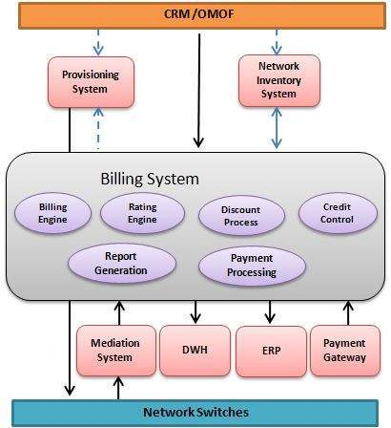
Functional requirements
Notes:
CRM (Customer Relationship Management)/OMOF (Order Management and Order Fulfilment) system contacts with the billing system and billing system contacts with provisioning system to provision the services and network inventory system as well to assign phone numbers or IP addresses, etc.
Second possibility could be that CRM/OMOF system itself contacts with provisioning system to provision the services and network inventory system as well to assign phone numbers or IP addresses, etc.

Slide 11
System Requirements Cont
CRM (Customer Relationship Management)/OMOF (Order Management and Order Fulfilment) system contacts with the billing system and billing system contacts with provisioning system to provision the services and network inventory system as well to assign phone numbers or IP addresses, etc.
Second possibility could be that CRM/OMOF system itself contacts with provisioning system to provision the services and network inventory system as well to assign phone numbers or IP addresses, etc.

Slide 12
System requirements :Independent apps
Customer-interface Management .
Order Management
Sales and Marketing
Rate Plans and Rating
Discounting
Invoicing
Credit Control & Collection
Notes:
A billing system should be composed of a series of independent applications that, when run together, are referred to as the billing system. A good billing system should provide the following major functionalities with a depth of flexibility −
C

Slide 13
System requirements :Independent apps Cont.
Problem Handling
Performance Reporting
Installation and Maintenance
Auditing & Security

Slide 14
Major Features
Rating & billing − It involves rating the products or services usage and producing monthly bills.
Payment processing − It involves posting of the customer's payments into his/her account.
Credit control and collections − It involves chasing the outstanding payments and taking appropriate actions to collect the payments.

Slide 15
Major features Cont
Disputes and adjustments − It involves recording customer's disputes against their bills and creating adjustment to refund the disputed amount in order to settle the disputes.
Pre-pay and post-pay services − It involves supporting both the pre-paid and the post-paid customer bases

Slide 16
Use case and process flow
A simple user-case scenario
Notes:
The system user navigates through the company site and views company services, and he decides to order one of the available services. If he has no account, he signs up for a new account, else he signs in. Then the user asks to conduct an order with the selected service. The service may be prepaid where he has to pay to have credits to use the service, or it may be postpaid, where he has to pay if the service has installation or setup fees, and later on he will pay for his usage of each billing cycle

Slide 17
Use cases Cont.
. The system user navigates through the company site and views company services
decides to order one of the available services.
If he has no account, he signs up for a new account, else he signs in
. Then the user asks to conduct an order with the selected service.
The service may be prepaid where he has to pay to have credits to use the service, or it may be postpaid, where he has to pay if the service has installation or setup fees, and later on he will pay for his usage of each billing cycle.

Slide 18
Benefits Of Convergence Billing system
Convergent billing would help operators in achieving the following major benefits −
Single product and service catalogue gives better time to market and reduced cost of implementation.
A unified bill enables cross-service discounts, so that customers who order multiple services can receive preferential pricing.
Convergent billing enables multi-service packaging and pricing, whereby existing customers are enticed to add new services and new customers are attracted by innovative service bundles.
Centralized customer care and support for both type of customers ( pre-paid and post-paid)

Slide 19
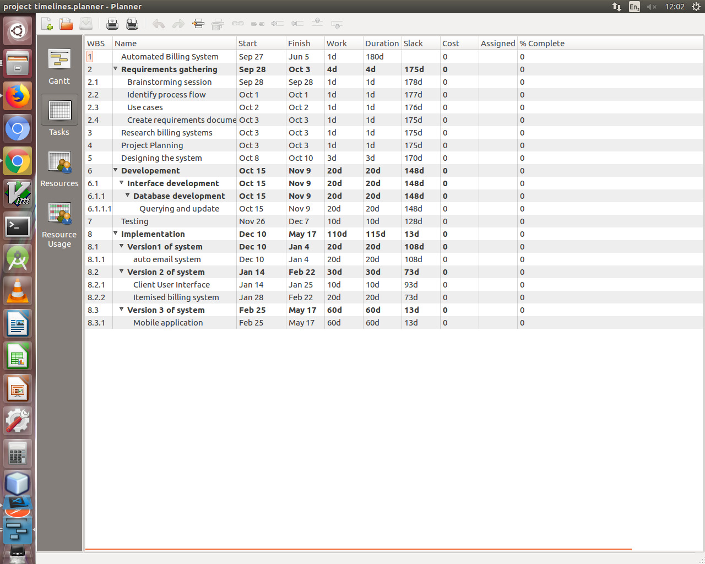
Time Planning

Slide 20
Q & A

